Slide 1
README
BURN AFTER READING
about_SlideDeck
The actual presentation starts with slide 6 ("Session title"). The first five slides have a purely organisational purpose. During the break before your session, you should start the presentation with slide 2 ("Next up"), so that the audience knows that they are in the right room. It's fine if you start chatting with the audience during this break, but we need a precise starting point for your presentation in terms of editing your video. That means:
The recording of your presentation will start after the countdown. Please (RE)START talking after the countdown, not during it! Otherwise your recording will start with a half sentence.
It is not necessary to explicitly signal to the PA operator, this is your signal!
Finally, do you have to use this slide deck? No, you are free to present the way you like it. But you are asked to use the intro slides: countdown, session title, sponsor slide. Beyond that, use what is good for the cause – from no slides to sketches from your children, from Jupyter to $youNameIt.
You will find additional information in the notes below.
Sincerely, your hosts!
Dear Speaker, we are thrilled and honored to have you with us in Malmö in 2025. Take your time and read this before you prepare your session.
Since most of you have been with us before, you will already know a lot about PSConfEU. You know that we try to capture all sessions carefully and publish your work on YouTube. There are a few easily avoidable stumbling blocks that we would like to draw your attention to:
Your screen resolution should be 1920x1080 px (FullHD)
You should provide a full size HDMI socket
Mirror your screen
Disable "Presenter View" in PowerPoint
Using MAC or Surface book? Be aware of HDCP!
Disable the ‘Night light mode’
Notes:
The fine print (additional information)
Why should you care about HDCP?
"High-bandwidth Digital Content Protection (HDCP) is a form of digital copy protection developed by Intel Corporation to prevent copying of digital audio and video content as it travels across connections. Types of connections include DisplayPort (DP), Digital Visual Interface (DVI), and High-Definition Multimedia Interface (HDMI), as well as less popular or now deprecated protocols like Gigabit Video Interface (GVIF) and Unified Display Interface (UDI)."
https://en.wikipedia.org/wiki/High-bandwidth_Digital_Content_Protection
Some notebooks ignore the HDCP standard, some vendors comply with the standard. Apple and Microsoft are somehow famous for strictly following the HDCP guidelines. Sadly, we will not be able to guarantee, that your session can be recorded in the latter case.
But you can do simple things, to overcome these problems. It is also very likely that you presented with your notebook before. So you will know, if this worked fine.If you are in doubt and if the agenda allows, try a dry-run a day before and connect everything.
In general you can easily bypass HDCP restrictions with a cheap splitter (the cheaper the better), just like the one you see below. This is an example device that we bought for 16 euros (in Germany).
Ask us, we will lend you such a device.
Thorsten also gave a whole presentation about "Broadcasting yourself" - easy steps to record yourself and create a (backup) session recording on your own. If you want to invest your time and dive deeper, take a look at his recordings and notes:
https://vimeo.com/thorstenbutz/byourself
This is of course completely voluntary, but perhaps you will find it helpful.

Slide 2
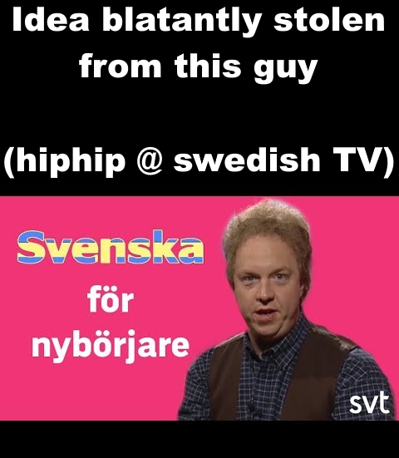

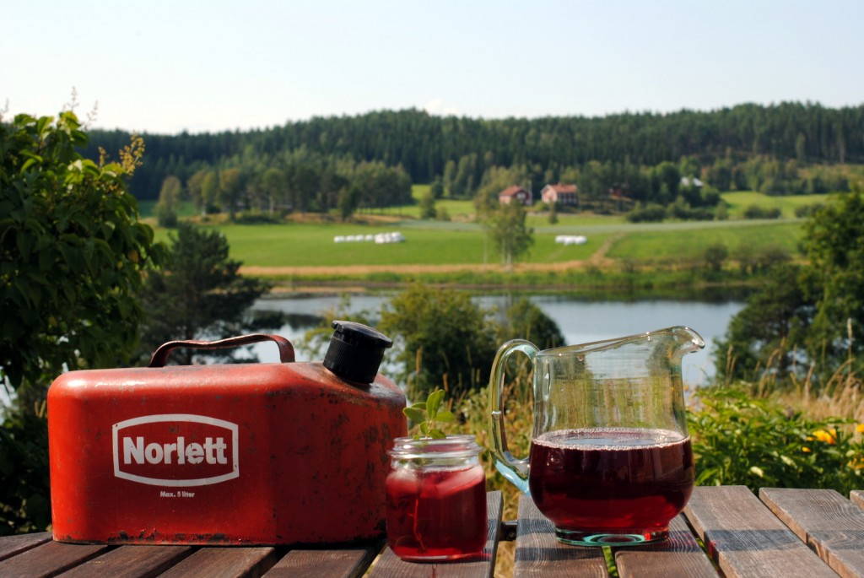
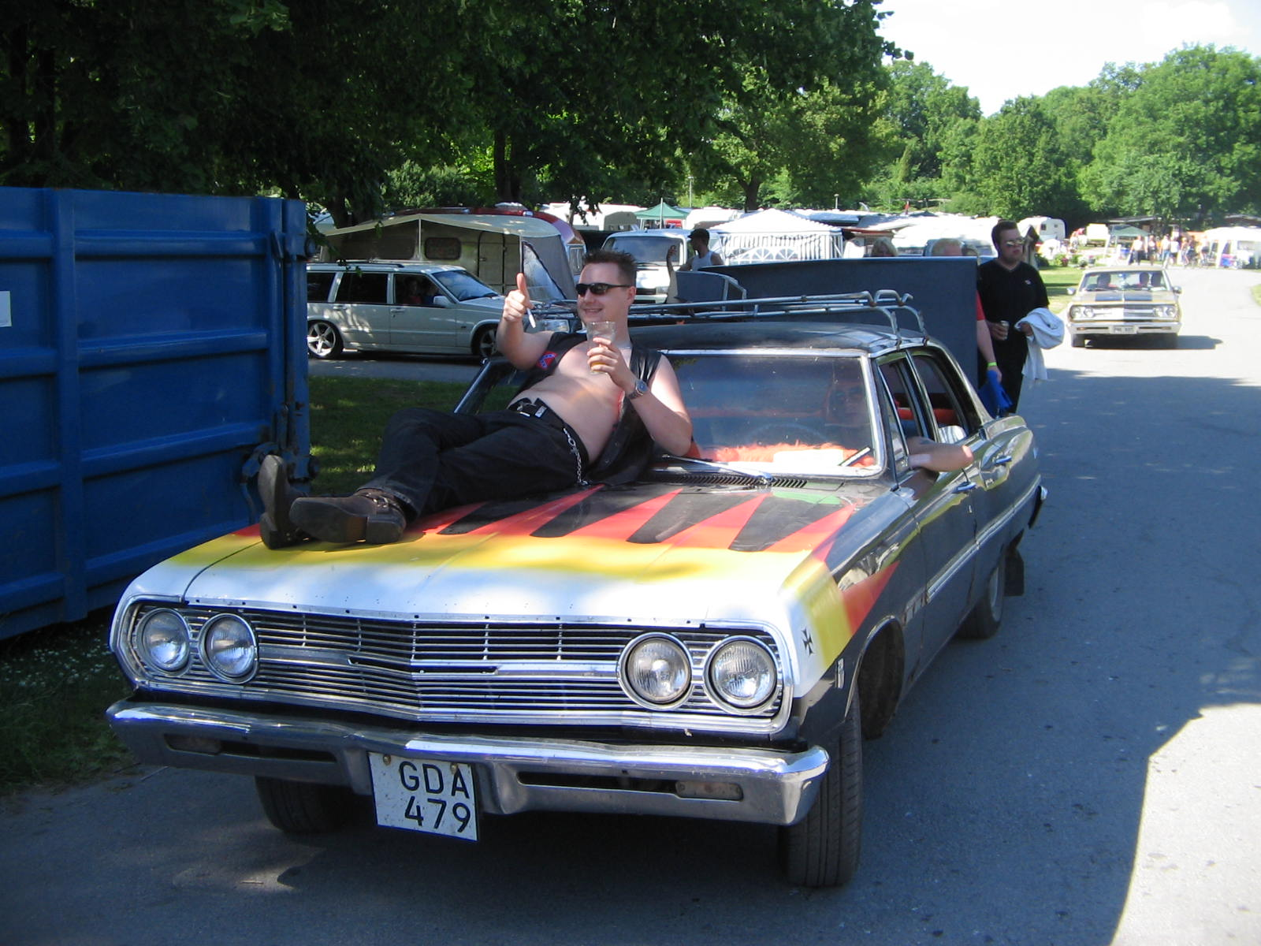
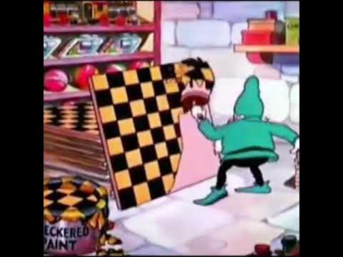
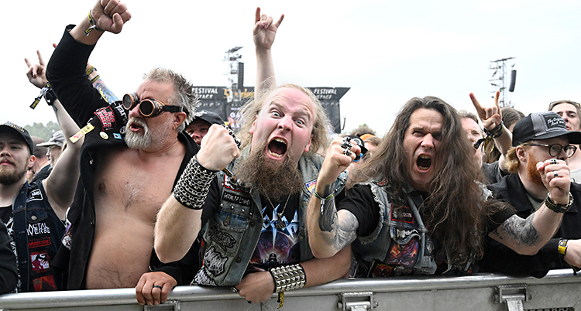
Saveinskaw fur neebewrjere - Swedish for beginners
Awk-ah fin-lawnds fur-jahw
Going by boat to finland
Raw-gahr jay-vell
Old American car fan
Schawk rewtig mawler fergh
Checkered paint
Lyst-near paw hurd rawkh
Listening to heavy metal music
Hewm short awk ling-awn dreek-awh
Moonshine and Lingonberry juice (Vargtass!)

Slide 3
Next Up:
Björn Sundling

Slide 4
3
3

Slide 5
2

Slide 6
1

Slide 7
Hardcore Git-Fu!
Björn Sundling

Slide 8


Many thanks to our sponsors:

Slide 9
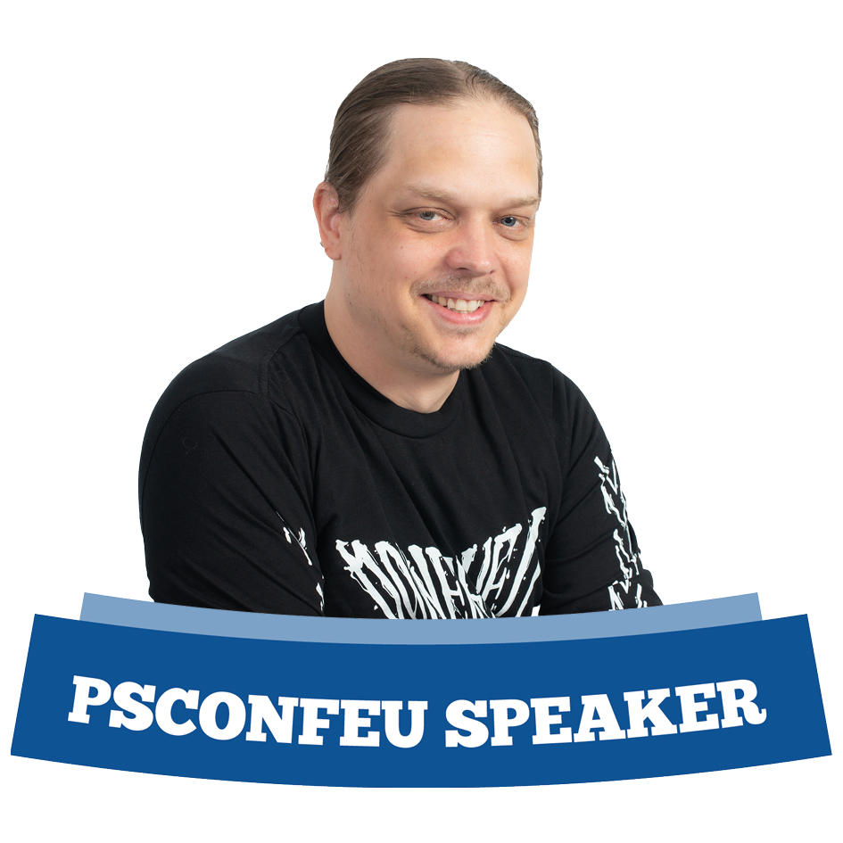
Björn Sundling
MVP, MCT, And lots of other cool titles.
Consultant @ Knowledge Factory, Advania
DevOps, PowerShell, Dog walking, metal playing, etc.. etc..
Definitely not a Git black belt…

Slide 10
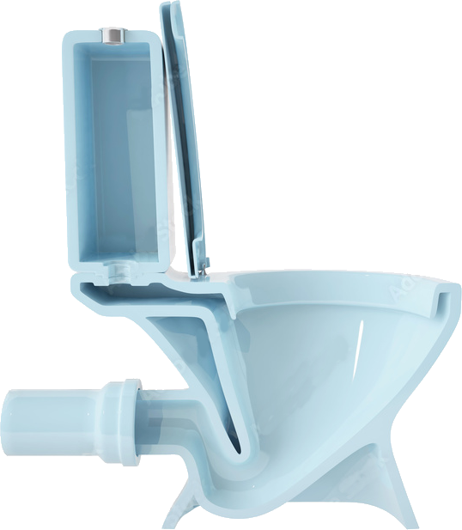
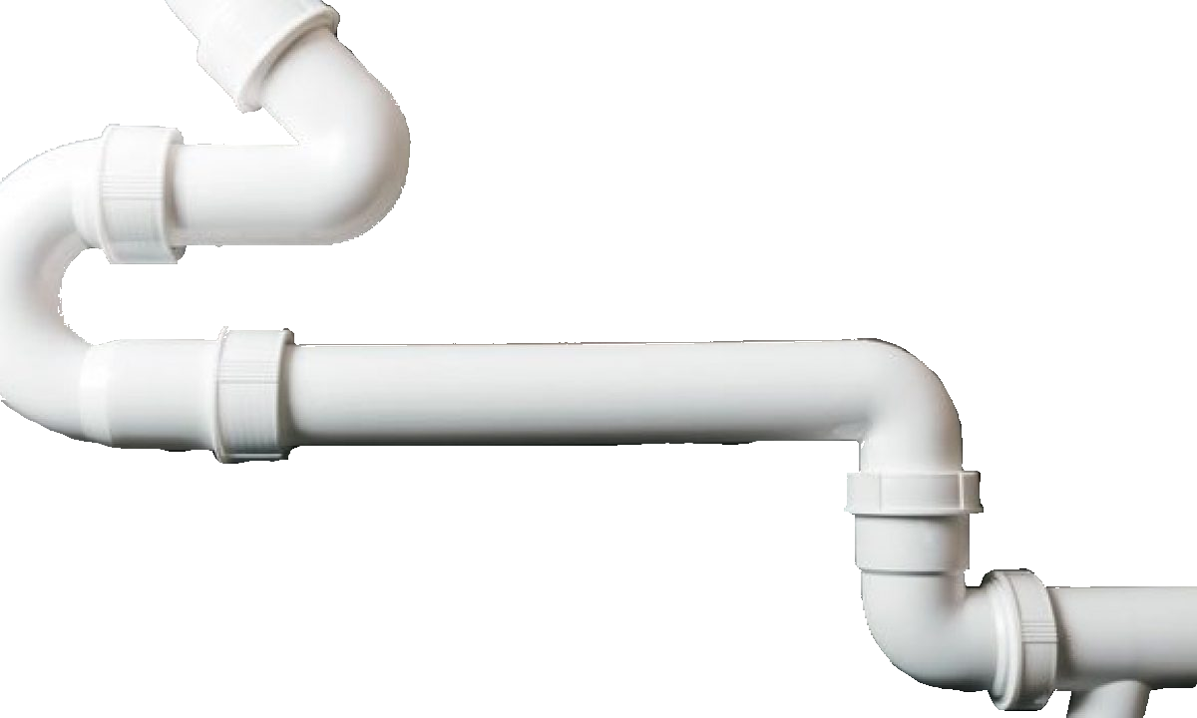
WTH GIT?!
~150 commands
~70 Plumbing commands
~80 Porcelain commands
About a bazillion parameters per command..
(There’s probably some cool way of enumerating this using PowerShell…)

Slide 11
Agenda(ish..)
Setup
not setup.exe – config 😉
Add and restore code
more than just “add”
Maintenance
Git – not just for versioning!
Cool stuff
(coolness may vary based on personal preferences…)

Slide 12
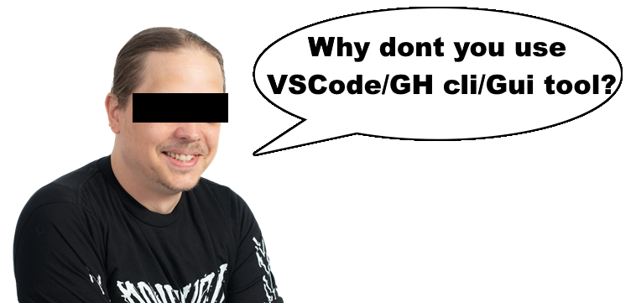
Pre session Q&A

Slide 13
Demos
Config.

Slide 14
Heads, coders, refs and toes..
Refs
References – a pointer to any tag, branch, PR, and more
/refs/<head/pull/tag>/<name>
head (lower case)
Named references to a commit at a branch tip
/refs/heads/<branch name>
HEAD (upper case)
Current branch – reference to a head
@ - “alias” for HEAD
~<n> - e.g HEAD~2
^<n> - e.g HEAD^2 - https://git-scm.com/docs/gitrevisions
Notes:
## checkout vs. switch vs. branch
# Checkout - checks out a branch. Use -b to create if not exists, and -B to create and reset if exists <- Old farts (like me) use Checkout..
#
# At some time checkout became ambiguous. It could do to much, and this led to confusion. Instead there was two new created commands
# git switch - Switch branches and additionally, if wanted, create them with -c/--create <- Modern people use switch
# git restore - restores file(s) to a previous state either from latest commit, or selected commit.
#
# Branch - Can do managing of branches. Add branches - git branch <name> <source ref> - or delete them - git branch --delete --force <branch name>

Slide 15
…Why’s and Where’s…
Modified – Working Directory
You changed your file, but have not committed any chages
Staged – Staging Area, Index
You have changes, added using “git add” but not committed
Committed - HEAD
Snapshot taken

Slide 16
.. And (something that rhymes with mouths) and remotes.
Local
Everything you fetched
Remote
Where you “push” stuff
Upstream
GitHub(?) invention for additional remote(s)

Slide 17
Demos
Add and delete stuff

Slide 18
Git behind the curtains
Each repo is worth the same
Which means “remote” is just what your computer knows from your server/host
Object based.. (Not Object oriented 😉)
I write Blobs, not filethingies
git clone --bare $remoteUrl

Slide 19
Demos
Maintenance

Slide 20
Demos
Cool stuff.
If we have the time..

Slide 21
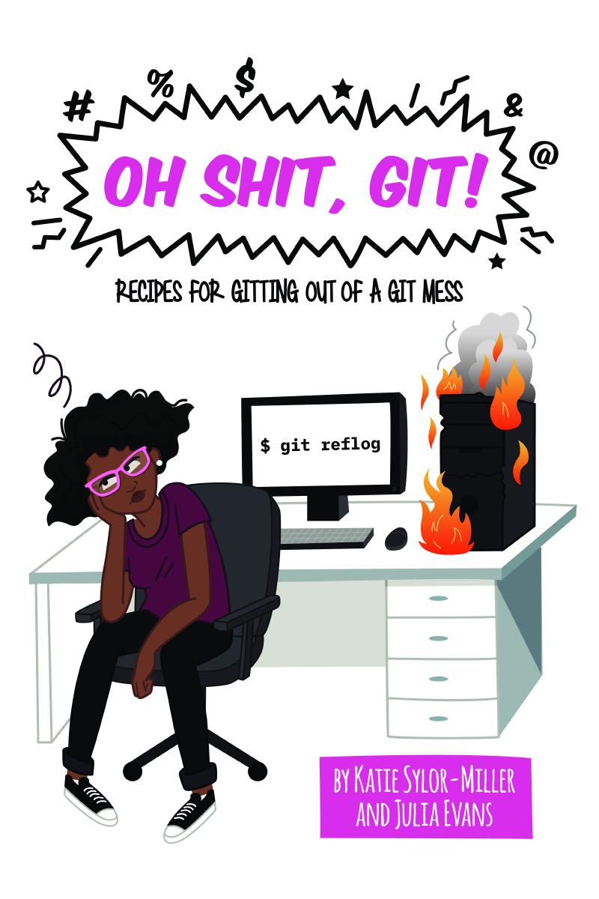
Git - Summary
Git is hard…
…a basic understanding of the inners makes it less hard…
... you will still mess up.

Slide 22
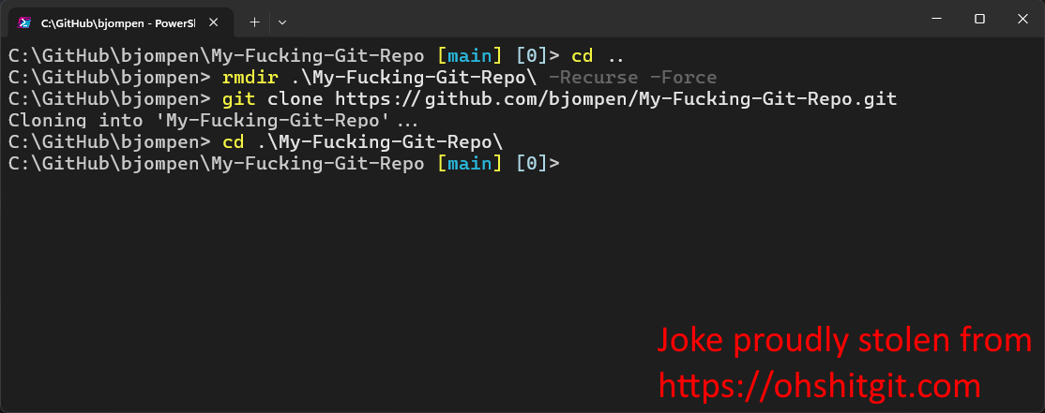

Slide 23
Q&A
15 minutes

Slide 24
Instructions
Use this template if you want, it’s preferred but not mandatory.
Please make sure our sponsors are mentioned on your first slide after the title.
Do not amend the ratio or the colours of the sponsors’ logo and background.
Update your twitter handle through the master page (see next slides).

Slide 25
Instruction (Continued)
The session is 30 min.
Then 15min Q&A.
At the end of your 45 min, please leave the room to the next speaker.
You’re welcome to continue the discussion in the Foyer area.

Slide 26
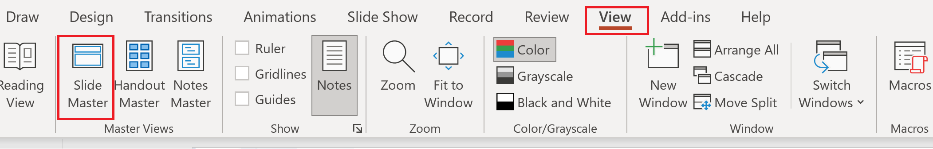
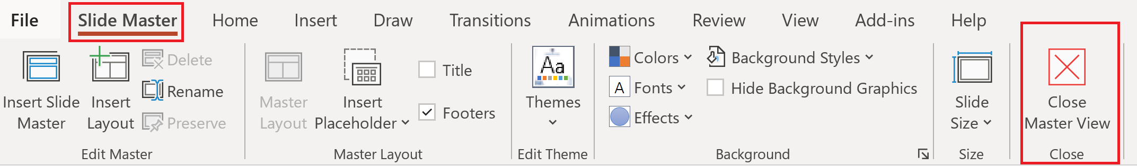
Update the twitter handle on the master slide
To open the slide master:
To close the Master view:
If you need any help, do not hesitate to email us at psconfeu@synedgy.com

